Slide 1
A Roadmap to Continuous Integration
Bruce Altner
Brett Lewinski
August 16, 2010

Slide 2
Overview
Introduction
What is Continuous Integration (CI)?
Best Practices in CI
The Tools of CI
CI in Practice: First Steps

Slide 3
Introduction:
The Problem to be Solved
Many of the problems encountered in software application deployments can be traced to reliance on manual processes to build, test, and package release targets.
Modern software development practices such as continuous integration (CI) focus on executing integration builds early and often, rather than waiting until the software product is almost ready to deliver.

Slide 4
Outline of the Presentation
Define CI and describe the benefits that may accrue to organizations that adopt it.
Examine CI concepts, best practices, and tools within the context of current industry usage and derive guidelines for an achievable adoption strategy.
Provide specific recommendations for implementing CI for teams at various levels of “maturity.”
Discuss and demonstrate the application of CI tools and practices in a real-world development environment.

Slide 5
Overview
Introduction
What is CI?
Best Practices in CI
The Tools of CI
CI in Practice: First Steps

Slide 6
What is CI?
The Build Cycle
There are many variations to the process, but the basic CI build cycle consists of these key steps:
  Developer commits changes to the source code repository
  Build server executes the master build script, or delegates execution to another server
    Checks out source code
    Builds executable version of the application
    Runs other jobs, such as testing and code inspection
  Team is notified of build results through a feedback mechanism
    If alerts are generated, the team takes immediate action to correct problems
    If a code fix is needed, developer commits the corrected code back to the repository; this action kicks off a new build cycle.

Slide 7
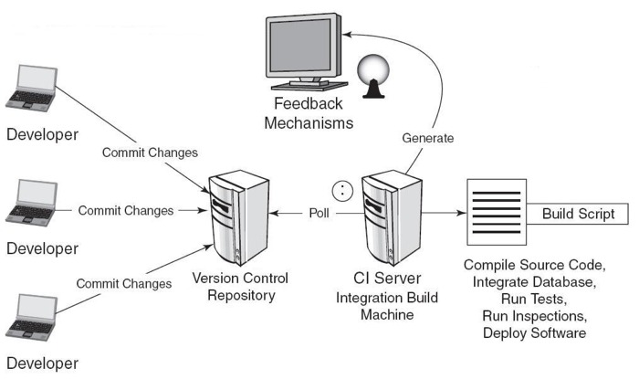
Architecture of a CI Build System
    The key to fixing problems quickly is finding them quickly.
    – (Fowler, 2006)
Figure 1: System and Software Architecture Supporting a CI Build
Definition: CI is the practice of regular, comprehensive, and automatic building and testing of applications in software development.

Slide 8
Artifacts Needed
A build usually involves more than source code files. Other items may include:
  Project and third-party components and libraries
  Configuration files
  Data files and database scripts
  Test scripts
  Build scripts
  Properties files
All items except project and third-party libraries should be stored in the source code repository.*
*Tools such as Apache Ivy provide straightforward ways to manage dependencies outside of the repository.

Slide 9
Essential Characteristics of a CI Build
  The build is completely automated, usually through the execution of a single script.
  No matter how triggered or how often run, a build always begins by retrieving code from the source code repository.
  Unless terminated prematurely, the end product of a build is always executable code.
  Notification of build status always occurs through a feedback mechanism.

Slide 10
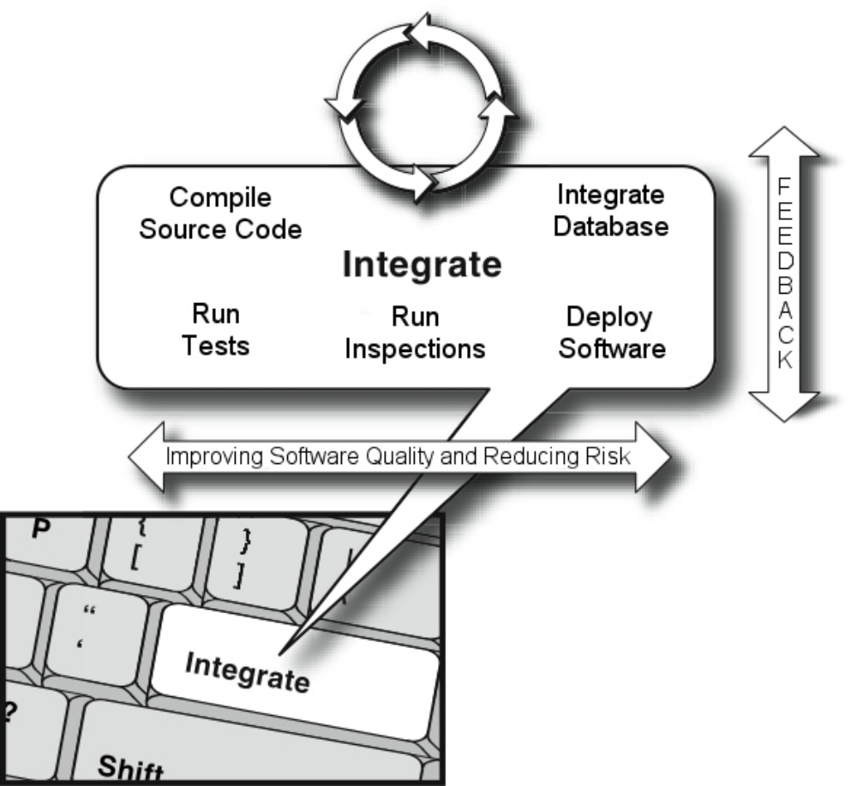
The “Integrate Button” Metaphor
Figure 2: The “Integrate Button” Metaphor
Source: Duvall et al. (2007)

Slide 11
Build Types
There are three basic types of builds: private, integration, and release
  All builds are automated, script-driven processes that pull source code from the repository and create deployable artifacts
  These build types differ in several ways
    Where, when, by whom, and for what reason they are run
    The code that feeds the process
    What is done with the output

Slide 12
Build Types (continued…)
Private Builds
  Run by developers in their local environments (IDE)
  Ensure that code compiles before committing back to source code repository
  Triggered manually
  Very stripped-down and designed to finish quickly
Integration Builds
  Compile and package the application for testing and quality inspection in response to recent changes
  Performed on a dedicated build server either on a scheduled basis (nightly) or continuously
  Usually drawn from the trunk of the repository tree
  Fast or slow depending on the number and type of processes included in the build script
Release Builds
  Performed when code is ready to be deployed to other environments
  Performed by the team’s release manager
  Use tagged code from the repository
  Run the full suite of automated and manual tests and inspections
  Tend to be slow

Slide 13
CI vs. Build Management
Property | Continuous Integration | Build Management
Build Type | Integration | Release
Purpose | To determine whether the latest integrated changes degraded the code quality | To produce an unambiguous set of artifacts to be released to third parties outside of development
Audience | Development team | QA, CM, Operations teams, etc.
Lifecycle | Development | Boundary between development and next application lifecycle stage
Source | Most current version in repository (trunk); always changing | Specific snapshot (tag); unchanging
Traceability | To newly integrated changes | To full source snapshot
Degree of Automation | Completely automated | Combination of automated scripts and manual processes
Artifacts | Artifacts are a mere by-product; quality determination is the primary output | Production of artifacts is instrumental to the purpose

Slide 14
The Importance of Fast Builds
In general, the more processes included in the build, the better the quality of the final product; however, there are tradeoffs.
Each subprocess takes time to execute; extra steps result in loss of productivity, as developers wait for long build cycles to complete before they can continue working.
Frustration with overly long builds* can be a significant roadblock to team acceptance of the CI process.
* Kent Beck, in his book Extreme Programming Explained (2004), suggests a 10-minute limit for basic integration builds. Some developers would consider even 10 minutes to be too long a time.

Slide 15
Improving Build Speed
Three approaches to dealing with build speed:
  Speed up the build by eliminating bottlenecks or by running the build on a faster machine with plenty of memory.
  Run complete builds less often or at a time when developers are less likely to be working, and run only basic builds on a continuous basis.
  Employ a “staged build” approach in which the basic build executes to validate code that developers have just checked in, after which a second process completes the remaining steps.
A combination of the three approaches is often used.

Slide 16
The CI Build Server
CI build servers provide many valuable services:
  Polling for changes in the source code repository, which trigger a new build
  Avoiding overlapping builds (due to repository commits very close together in time) by specifying a configurable quiet-time interval
  Support for different scripting tools and source code repositories
  Support for a variety of notification mechanisms
  Logging of build results to provide a history of previous builds
  Tagging of build numbers
  Web-based configuration and reporting of build results
  Support for distributed builds via a master/slave architecture

Slide 17
Automated Processes:
Continuous Testing
Automated testing is an important component of the CI build cycle.
Test Type | Description | Impact on CI Build
Unit | Tests discrete units of code to verify correct behavior; written and performed by developers as part of the development process. | Easily included in the build cycle; very low impact on build speed.
Integration/ Component | Tests to verify specific components, including their interaction with other internal and external components; may exercise code not exposed to clients or end users. | May be included in the build cycle; tends to run longer than unit tests so there is some impact on build speed.

Slide 18
Continuous Testing (continued…)
Test Type | Description | Impact on CI Build
Functional (Regression) | Tests all aspects of the fully deployed system, exercising all actions that may be taken by end users; may use a wide range of input data to force errors; fully aligns with use cases; specialized tools allow feature-by-feature capture of user actions as executable scripts that can be run on an automated basis. | The impact on build speed may be significant; should not be a part of builds that run every time code changes; appropriate for nightly runs or a staged build process.
Functional (Targeted) | Tests only specific features that were changed for a particular build. | Minimal impact on build speed since only a small part of the full application is tested.

Slide 19
Continuous Testing (continued…)
Test Type | Description | Impact on CI Build
Load | Subjects the application to levels of use approaching and beyond the limits of its specification to ascertain the maximum amount of work a system can handle without significant performance degradation. | The impact on build speed may be significant; should not be a part of builds that run every time code changes; appropriate for nightly runs or a staged build process.
Stress | Evaluates the extent to which a system keeps working when subjected to extreme work loads or when some of its hardware or software has been compromised; includes availability or resistance to denial of service (DoS) attacks. | The impact on build speed may be significant; should not be a part of builds that run every time code changes; appropriate for nightly runs or a staged build process.

Slide 20
Continuous Testing (continued…)
Test Type | Description | Impact on CI Build
Security | Used in conjunction with manual or automated functional testing. Many types of tools for web application security assessment exist, such as source-code analyzers, web application (black-box) scanners, database scanners, binary analysis tools, runtime analysis tools, conﬁguration analysis tools, and proxies. Proxies, for example, watch what the user or test script does and report potential security holes. | The impact on build speed could be significant; should not be a part of builds that run every time code changes; appropriate for nightly runs or a staged build process.

Slide 21
Continuous Database Integration
Changes to an application database may occur often during the course of project development.
  Early detection of problems in this component is as important as early detection of errors in the source code.
  A build server can be set up to begin a new CI cycle whenever the project database is to be changed.
  Code and configuration files that modify the database are committed to the version control repository just as code changes are and can trigger a new build.

Slide 22
Continuous Database Integration (continued…)
A CI build can:
  Drop an existing database
  Create, configure, and populate a new one with data
  Run automated unit tests to verify that everything is working as expected
  Inspect database scripts for compliance with project practice
One of the primary benefits of applying the practices of CI to database integration is that it frees developers from the fear of making changes.

Slide 23
Continuous Code Inspection
A stated objective of CI is to integrate frequently in order to detect and remedy quality issues as they are introduced.
  Code quality issues are not just errors that cause compile-time or runtime problems.
  Tangled, hard-to-read, overly complex, undocumented, and inconsistently formatted code may compile, but committing this kind of code to the repository is not a good practice.
  Many teams apply stylistic standards for “clean” code in their particular language, a process that can be automated.

Slide 24
Continuous Code Inspection (continued…)
Automated processes are very good at code inspection, once a set of standards has been defined.
  Noncompliance with team standards can cause a build to fail or simply to be reported.
  Tools are available for most programming languages.
  Rules can be based on a project's coding standards.
  Can be run inside an IDE or in a build tool such as Ant.
  Tools are available to not only enforce style and format compliance but also reduce code complexity, eliminate duplicated code, and ensure complete unit test coverage.
Continuous code inspection allows the team to concentrate on the important issues during peer reviews, such as alignment with requirements and sound architecture and design.

Slide 25
Continuous Deployment
Continuous deployment is “…a culmination of practices and steps that enable us to release working software any time, in any place, with as little effort as possible.”
  The build includes compilation, running all tests and inspections, packaging, and deployment.
  “Any place” implies not only developer servers, but also QA and production servers.
Several of the steps prescribed for it cannot be automated.
  It requires creating a snapshot of the releasable code in the source code repository.
  It requires testing by human testers.
  Solution is to automate as much as possible and do the rest manually.

Slide 26
Feedback
Is essential to the purpose of CI
  Without notification the team has no way of knowing whether recent changes introduced new problems.
Can take many forms and be directed at many stakeholders
Must be managed carefully
  “Spam Feedback” is a CI anti-pattern in which team members become inundated with build status e-mails, to the point where they start to ignore messages.
Is most effective when it directs the right information to the right people in the right situation and uses the right methods

Slide 27
Feedback (continued…)
There are many ways to send notification of build status:
  E-mail: Provides build status at discrete points in time
  RSS: Pushes alerts regarding build status to an RSS reader
  SMS: Provides build status with text messages sent to cell phone
  Visual devices: Ambient Orb, X10 Lava lamps
  Twitter: Provides build status with “tweets” sent to Twitter account
  Sounds: Provides build status through sound
  Displays: Provides feedback through an LCD monitor
  Instant Message: Allows for instantaneous notification via IM
  Browser plug-ins: Provides build status in the browser status bar
  Widgets: Display the build status on the user's desktop

Slide 28
Benefits of CI
Increased productivity
  Enables shorter feedback cycle when changes are made
  Code is kept in a “releasable” state
  Code gets back into the hands of testers quickly
  Frees the team to do more interesting and valuable work
  Improves morale, making it easier to retain good developers
  Enables more frequent releases with new features
Improved quality
  Makes it easier to find and remove defects because frequent integration and testing identifies bugs as they are introduced.
  Multi-platform builds help in finding problems that may arise on some, but not all, versions of the supported platform.
Reduced Risk
  Reduces uncertainty greatly because at all times the team knows what works, what does not, and what the major issues are.

Slide 29
Barriers to CI
Why doesn't every team already practice CI?
  It is not easy.
  Establishing a solid CI practice takes a lot of work and technical knowledge.
  A number of new tools and processes must be mastered.
  Setting up a CI server requires that the build, unit test, and executable packaging processes all be automated.
  Requires mastering a build scripting language, a unit testing platform, and potentially a setup/install platform as well.
Duvall (2007) says, “I often hear statements like ‘CI doesn't work for large projects’ or ‘our project is so unique that CI won't work’ when, in fact, CI isn't the issue at all — it's the ineffective application, or nonexistence, of certain practices that have led to frustration.”

Slide 30
Overview
Introduction
What is Continuous Integration (CI)?
Best Practices in CI
The Tools of CI
CI in Practice: First Steps

Slide 31
Best Practices:
The Enterprise CI Maturity Model
A defect in the software is a defect in the process.
– Graham (2005)
The maturity level of an organization’s CI processes depends on its needs and the availability of resources.
Minick and Fredrick (2009) describe a maturity model for CI* that spans a broad range of sophistication, from “introductory” to “insane” along four attributes.
  The early levels are the domain of “team-level CI.”
  The advanced and insane levels characterize “enterprise CI” (implies the need for strict compliance with development process regulations or standards).
The “best practices” described within each level provide a convenient roadmap to adopting CI.
* The CI Maturity Model is to CI what Capability Maturity Model Integration (CMMI) is to organizational process improvement.

Slide 32
Enterprise Maturity Model (continued…)
Level Attribute | Introductory | Novice | Intermediate | Advanced | Insane
Building |  Standardize the build process Dedicated build machine Solid source control | Automate execution of build steps Daily builds | · Dependency repository Distributed builds Continuous builds | Track CI configuration changes Access control of CI configuration changes | Exact replication of environ-ments Build from VM snapshots
Deploying |  Helper scripts | Fully scripted process | · Automated deployment to test environments Mostly standardized across environments | Pushbutton production deployment Gated, automatic promotions Fully standardized deployments | Fully automated production deployments
Legend:  Industry Norm  Target

Slide 33
Enterprise Maturity Model (continued…)
Level Attribute | Introductory | Novice | Intermediate | Advanced | Insane
Testing |  Some test automation | Regression tests run with every build Respond immediately to test failures | Some static inspections Automated functional tests | · Extensive unit tests Extensive automated functional tests Risk-based manual tests Security scans | 100% test coverage
Reporting | Tool-based reports Team takes actions based on reports |  All teams publish their own reports (siloed) | Historical reports Access to reports by other teams Basic report analysis | · Trending reports Analysis of reports by other teams | Predictive modeling
Legend:  Industry Norm  Target

Slide 34
Overview
Introduction
What is Continuous Integration (CI)?
Best Practices in CI
The Tools of CI
CI in Practice: First Steps

Slide 35
Build Servers
    The most important criterion in choosing a tool is whether it does what you need it to do.
    -- Duvall et al. (2007)
A comprehensive and up-to-date listing of the many open source and commercial CI build servers available today is maintained on the ThoughtWorks CI Feature Matrix.*
  At this time, 25 products are compared on dozens of attributes.
  Adds products and attributes as they are identified.
  Attempts an unbiased comparison of servers to assist teams considering CI adoption in selecting an appropriate product.
  Identifies the most important features for companies and projects involved in the developing CI build servers.
  Does not provide market share information.
* See http://confluence.public.thoughtworks.org/display/CC/CI+Feature+Matrix

Slide 36
Build Servers:
What are People Saying?
Using an online survey of software professionals with an interest in CI, Fleisher (2009) attempted to learn which CI servers people are using and why.
He identified 12 products and reported their support for:
  automated build tools
  version control systems
  build triggers
  test frameworks
  notification mechanisms
  integration with IDEs
  access control
  multi-platform builds
  history builds
  virtualized environments
  extensibility

Slide 37
Build Servers:
Survey Results
CI Servers from Fleisher (2009)
Solution | Company/Project | Open Source | First Release | URL
AnthillPro | Urbancode | ‐ | 2001 | http://www.anthillpro.com
Bamboo | Atlassian | ‐ | 2007 | http://www.atlassian.com
Continuum | Apache project | yes | 2005 | http://continuum.apache.org
Cruise * | ThoughtWorks | ‐ | 2008 | http://studios.thoughtworks.com/cruise
CruiseControl | Sourceforge project | yes | 2001 | http://cruisecontrol.sourceforge.net
FinalBuilder | VSoft Technologies | ‐ | 2001 | http://www.FinalBuilder.com
Hudson | java.net project | yes | 2007 | http://hudson.dev.java.net
Lunt build | Javaforge project | yes | 2004 | http://luntbuild.javaforge.com
Parabuild | Viewtier | ‐ | 2005 | http://www.viewtier.com
Pulse | Zutubi | yes | 2006 | http://www.zutubi.com
Quick build ** | PMEase | yes | 2004 | http://www.pmease.com
TeamCity | JetBrains | yes | 2006 | http://www.jetbrains.com/teamcity
* Cruise is a successor to CruiseControl
** Quick build is the commercial version of Lunt build

Slide 38
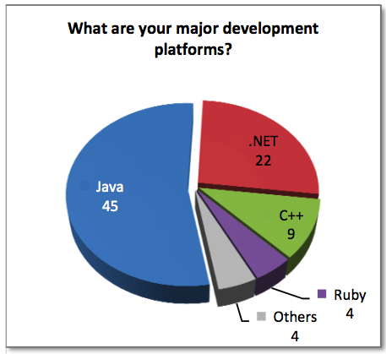
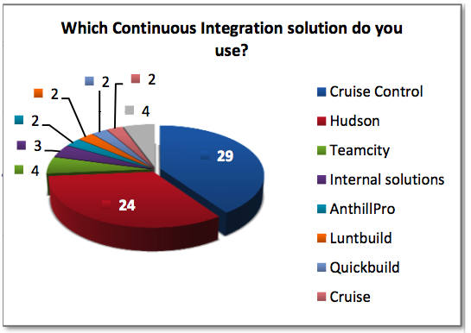
Build Servers:
Survey Results (continued…)
Source: Fleisher (2009)
It is not surprising that CruiseControl fared so well in this survey, since it has been around the longest of any of the open source solutions (since 2001). What is worth noting is the strong showing by Hudson, a full-featured but rather new entry in the field (since 2007).

Slide 39

Build Servers:
CruiseControl vs. Hudson
Big Bee Consultants compared CruiseControl and Hudson in an operational environment (Beton, 2009), using the following criteria:
Stability
Means of configuration
Dashboard security
Project grouping
Access to logged information
Support for Subversion
Support for distributed builds
Analysis of output from code inspection tools
Build triggering and aborting
Build history management
Documentation
In almost every case, Hudson (that’s me) came out the clear winner!

Slide 40
Automated Build Tools
Build automation is the scripting of tasks that developers perform in preparing their applications for deployment to runtime environments. Tasks include:
  Version control integration
  Dependency resolution
  Code quality analysis
  Compiling source code into binary code
  Packaging the binary code into deployable archives
  Running tests
  Deployment to different environments
  File system manipulation (creating, copying, and deleting files and directories)
  Creating documentation and or release notes

Slide 41
Automated Build Tools (continued…)
Tool | Platform | Description
Ant | Java | Most widely-used build tool for Java; extensive functionality; uses XML configuration; run from command line or various build servers and IDEs http://ant.apache.org/
Maven 1 | Java | A software “project management” tool; manages project build, reporting, and documentation from a central piece of information; integrated dependency management http://maven.apache.org/maven-1.x/
Maven 2 | Java | Same as Maven 1 but significantly enhanced with many new features and better performance; support for transitive dependencies; improved plug-in architecture http://maven.apache.org/
Gant | Groovy/Java | An alternative way of scripting things with Ant, uses the Groovy programming language rather than XML to specify the rules http://gant.codehaus.org/
Nant | .NET | .NET build tool. In theory it is like make without make's “wrinkles.” In practice it is a lot like Ant, including using XML as a scripting syntax http://nant.sourceforge.net/
setup.py | Python | The standard setuptools module included in Python http://pypi.python.org/pypi/setuptools
Pip | Python | A modern replacement for the standard Python package installer (easy_install) with native support for most version control systems http://pip.openplans.org/
virtualenv | Python | Provides virtualized Python installs so you can have multiple Python projects on the same system without the possibility of interference or needing administration rights to install software http://pypi.python.org/pypi/virtualenv
Buildout | Python | A Python-based build system for creating, assembling and deploying applications from multiple parts, some of which may be non-Python-based. It lets you create a buildout configuration and reproduce the same software later http://www.buildout.org/

Slide 42
Automated Test Tools: Unit Testing
Unit testing tools are ubiquitous. This is a small selection of the better-known products. For a comprehensive listing in a multitude of languages, see: http://en.wikipedia.org/wiki/List_of_unit_testing_frameworks.
Tool | Platform | Description
Junit | Java | The de facto standard for unit testing in Java http://junit.org/
TestNG | Java | Designed to overcome many of the perceived deficiencies of JUnit; supports test groups, dependencies, and parallel testing; integrates well with IDEs and build tools and servers http://www.testng.org
Cactus | Java | Cactus is a simple test framework for integration unit testing server-side java code (Servlets, EJBs, Tag Libs, Filters, etc. http://jakarta.apache.org/cactus/
DbUnit | Java | A JUnit extension targeted at database-driven projects that, puts the database into a known state between test runs; has the ability to export and import your database data to and from XML datasets http://www.dbunit.org/
Nunit | .NET | Includes GUI, command line, integrates into VisualStudio with ReSharper http://www.nunit.org
PyUnit | Python | The Python language version of JUnit; part of Python's standard library http://pyunit.sourceforge.net/
Nose | Python | A discovery-based unittest extension; includes many options including code test coverage http://somethingaboutorange.com/mrl/projects/nose/
MXUnit | ColdFusion | Unit Test Framework and Eclipse Plugin for CFMX http://mxunit.org/
CFUnit | ColdFusion | CFUnit is a unit testing framework for ColdFusion modeled after the JUnit framework http://cfunit.sourceforge.net/
CFCUnit | ColdFusion | A full-fledged framework for unit testing ColdFusion code based on JUnit http://www.cfcunit.org/cfcunit/

Slide 43
Automated Test Tools:
Performance Testing
    Most compilations of software performance testing tools on the Internet do not differentiate among the different types, so tools for load testing, stress testing, stability testing, etc., are lumped together under “performance testing.” For example, see http://www.opensourcetesting.org/performance.php.
Tool | Platform | Description
JMeter | Java | An open source desktop application designed to load test functional behavior and measure performance; 100% Java; originally designed for testing Web Applications but has since expanded to other test functions; extensive documentation describes how to use its many features and provides many examples; a special Ant task allows for automation by executing load tests while providing a way to pass in optional parameters and properties (see Duvall, 2008). http://jakarta.apache.org/jmeter/
Funkload | Python | Automated functional testing and detailed performance analysis http://funkload.nuxeo.org/
PyLot | Python | PyLot: performance and scalability testing, with correct result validation http://www.pylot.org/gettingstarted.html

Slide 44
Automated Test Tools:
Web Application Functional Testing
    Among the many compilations of links to functional test sites found was the one at SoftwareQATest.com
    (http://www.softwareqatest.com/qatweb1.html#FUNC).
Tool | Platform | Description
Selenium Remote Control (RC) Selenium Integrated Development Environment (IDE) | Web/Java | Created in 2004, Selenium RC is a test tool that allows the tester to write automated web application UI tests in any programming language against any HTTP website using any mainstream JavaScript-enabled browser. Selenium RC comes in two parts. A server that automatically launches and shuts down browsers and acts as a HTTP proxy for web requests from them. Client libraries for the preferred computer language (Java, Python, Perl, Ruby, PHP, C#, etc.). Selenium IDE is a complete integrated development environment for recording, editing, and running Selenium tests. It is implemented as a Firefox plug-in. Tests written with Selenium IDE may be run later on Selenium RC, since both products use the same test execution engine, known as Selenium Core. http://seleniumhq.org/projects/remote-control/ http://seleniumhq.org/projects/ide/
Windmill | Web/Python | Windmill is a web testing tool designed to automate testing and debugging web applications http://www.getwindmill.com/

Slide 45
Automated Test Tools:
Web Application Functional Testing
(continued…)
Tool | Platform | Description
WebTest | Web/Java | Canoo WebTest is a free open source tool for automated testing of web applications that has existed since 2001. WebTest is plain Java and runs everywhere as long as there is a Java development kit installed on the operating system. WebTest scripts are Ant scripts, which means an easy integration path to CI servers such as CruiseControl and Hudson. Simple and fast, no display is needed (uses HtmlUnit), although Javascript support is not as good as in "normal" browser. Easily extended using Java or Groovy http://webtest.canoo.com/
twill | Web/Python | twill is a simple scripting language that allows users to browse the Web from a command-line interface http://twill.idyll.org/
Funkload | Web/Python | Automated functional testing and detailed performance analysis http://funkload.nuxeo.org/

Slide 46
Automated Test Tools:
Security Testing
    SoftwareQATesting.com also lists many projects in the subject area of Web site security testing (see http://www.softwareqatest.com/qatweb1.html#SECURITY).
Tool | Platform | Description
ratproxy | Web | Ratproxy is a web application security auditing tool. It is a passive proxy, watching data sent between a browser and a web application. Detects and prioritizes broad classes of security problems, such as dynamic cross-site trust model considerations, script inclusion issues, content serving problems, insufficient XSRF and XSS defenses, and much more. When you test a web application, either manually or using Selenium, ratproxy can watch what you are doing and report any potential security holes it sees. http://code.google.com/p/ratproxy/
Paros | Web | Another proxy with active scanning support and varying degrees of automation http://www.parosproxy.org/
WebScarab | Web | Another proxy with active scanning support and varying degrees of automation; available through the Open Web Application Security Project (OWASP), a worldwide free and open community focused on improving the security of application software http://www.owasp.org/index.php/Category:OWASP_WebScarab_Project

Slide 47
Code Inspection Tools
There are many tools that provide code inspection via static and dynamic analysis of the source code. A partial listing is shown:
Tool | Platform | Description
Checkstyle | Java | Checkstyle is a development tool to help programmers write Java code that adheres to a coding standard. It automates the process of checking Java code to spare humans of this boring (but important) task. http://checkstyle.sourceforge.net/
JavaNCSS | Java | JavaNCSS is a simple command line utility that determines the lengths of methods and classes (a metric for complexity) by examining the Java source code. http://www.kclee.de/clemens/java/javancss/
JCSC | Java | JCSC is a powerful tool to check source code against a highly definable coding standard and potential bad code; similar to Checkstyle. http://jcsc.sourceforge.net/
PMD | Java | PMD scans Java source code and looks for potential problems such as possible bugs, dead code, suboptimal code, overcomplicated expressions, and duplicated code. http://pmd.sourceforge.net/
FindBugs | Java | A program which uses static analysis to look for bugs in Java code; looks for bug patterns, inspired by real problems in real code. http://findbugs.sourceforge.net/
Sonar | Java | Sonar leverages the existing ecosystem of quality open source tools (e.g., Checkstyle, PMD, Maven, Cobertura, etc.) to offer a fully integrated solution to development environments and continuous integration tools. http://sonar.codehaus.org/
Clover | Java | Clover measures code coverage generated by system tests, functional tests or unit tests, allowing you to improve test quality and find bugs sooner. (Commercial). http://www.atlassian.com/software/clover/
Cobertura | Java | Cobertura is a free Java tool that calculates the percentage of code accessed by tests. It can be used to identify which parts of a Java program are lacking test coverage. It is based on jcoverage. http://cobertura.sourceforge.net/

Slide 48
Code Inspection Tools (continued…)
Tool | Platform | Description
EMMA | Java | Another free Java code coverage tool. http://emma.sourceforge.net/
FxCop | .NET | FxCop is an application that analyzes managed code assemblies and reports information about the assemblies, such as possible design, localization, performance, and security improvements. http://msdn.microsoft.com/en-us/library/bb429476(VS.80).aspx
Ncover | .NET | NCover is a test coverage tool for the .NET platform; (Commercial). http://www.ncover.com/
Pylint | Python | Pylint is a python tool that checks if a module satisfies a coding standard; checks line-code length, variable name standard compliance, and more. http://www.logilab.org/857
Pyflakes | Python | Pyflakes is a program that analyzes Python programs and detects various errors. It works by parsing the source file rather than importing it, so it is safe to use on modules with side effects. http://freshmeat.net/projects/pyflakes/?branch_id=60662&release_id=208696
Clone Digger | Python | Reports code in Python or Java programs which appears to be very similar (even with slight variations); a good place to look for bugs and bad practice. http://clonedigger.sourceforge.net/
JSLint | Python | The popular JavaScript lint utility from jslint.com (http://jslint.com) can be run from the command-line using Rhino. http://www.jslint.com/rhino/index.html
CSS Validator | Python | Can be run as a command-line tool as of earlier this year. http://jigsaw.w3.org/css-validator/DOWNLOAD.html
Coverage.py | Python | Provides annotated code coverage reports and has been integrated into several of the common Python test suites, such as Nose. http://nedbatchelder.com/code/modules/rees-coverage.html
QueryParam Scanner | ColdFusion | qpScanner is a simple tool that scans the ColdFusion codebase checking to see if there are any CFML variables in queries that are not contained within a cfqueryparam tag. http://qpscanner.riaforge.org/
varScoper | ColdFusion | varScoper is a code scanning tool that can be used to identify variables that are not explicitly scoped to be local or global to a ColdFusion function. http://varscoper.riaforge.org/

Slide 49
Overview
Introduction
What is Continuous Integration (CI)?
Best Practices in CI
The Tools of CI
CI in Practice: First Steps

Slide 50
Current Practices
Continuous Integration represents a way of thinking about your development process rather than a concrete or speciﬁc technique.
– Cauldwell (2008)
At this time, a few development groups have processes in place that might be considered “pre-CI”:
  Software assets are centralized in a source code repository, and a consistent file structure is used.
  Deployment branches are created prior to a release to isolate releasable code from the main line of ongoing development.
  Code in Subversion is tagged as part of the release process although builds are not labeled.
  Defects are tracked via Trac tickets.

Slide 51
Current Practices (continued…)
  Ant is used to drive the build process, although it is run manually.
  Ivy is used for dependency management.
  A scripted build out of an application to a clean environment is run to deploy software, although for most teams this is manually driven.
  Unit testing is done on many parts of an application although coverage across the whole application is incomplete, and the tests are not always run when other code changes.

Slide 52
Current Practices (continued…)
  Database scripts are under version control although these are usually run manually, as needed, to update local copies and are released to DBAs for execution as part of deployments.
  Private builds are run before committing code so as not to break the build.
  Coding standards are discussed and implemented, although code is not inspected automatically, nor is compliance with adopted standards enforced.
  Peer reviews are held to improve requirements tracking and design.

Slide 53
Current Practices:
Gaps
The above items may show many teams are ready for entry-level CI, but there are still huge gaps that we are working to address:
  Practices across all teams are not consistent; some teams are ahead of the CI curve, others are behind.
  Practices within teams are not consistent, even for those who are ahead of the curve.
  There is little or no true automation of any processes.
  Unit and integration testing is sporadic and coverage is incomplete.
  Thorough functional testing is usually delayed until the code is handed to the testers.
  Not all teams use the Subversion repository correctly and consistently.
  Build and release management practices leave too much opportunity for error and have little traceability.

Slide 54
Development Environments
Four major development environments are used by the development teams: ColdFusion, .Net, Python, and Java.
  This diversity presents challenges to a one-size-fits-all approach.
  CI is neutral about programming language and platform, but tool availability is another matter.
    Many of the Java-based tools such as Ant and Hudson can be used by any language.
    Specific “x-unit” unit testing frameworks are also available for ColdFusion, Python, and .Net.
  Thus, the guidelines and practices recommended for CI adoption can be applied to all existing development environments, although some variation in the specific tools used is expected.

Slide 55
Recommendations:
Policy, Planning, and Management
  Establish a viable governance framework. CI is not only a technical implementation, it is also an organizational and cultural implementation.
  Establish a “CI Implementation” working group. Management should set up a software development technical leadership working group to lead CI adoption and other software quality and process improvement initiatives through training and technical support.
  Insist on proper use of version control systems. An improperly used source control system can easily derail efforts to implement CI.
  Enforce proper release management. The CI Implementation working group should take steps to clearly define, document, and enforce policies and guidelines for proper software release practices.

Slide 56
Recommendations:
Technology Implementation
  Adopt CI practices incrementally. Each team should honestly assess where on the maturity scale it is at a given point in time and put in place the changes needed to move to the next level.
  Implement CI early in new projects. Teams should focus their CI implementation efforts on new projects: maintenance releases, defect fixes, and new development and implement their CI practices early.
  Acquire and install fast machines for the CI build and test servers. High-performance servers will result in faster builds, removing one of the most important roadblocks to CI adoption.

Slide 57
Recommendations:
Technology Implementation (continued…)
  Start with the most knowledgeable teams. Initial attempts to adopt CI practices should start with the teams that already have some of the key practices in place.
  Write scripts to automate manual processes. Teams should decide which manual processes are causing the most problems and automate these first. The benefits of doing this will motivate them to tackle the next problem area, and so on.
  Get serious about automated testing. Detecting defects early depends on having all the necessary testing resources in place. No implementation of CI should be attempted without a commitment by all stakeholders to upgrade the department’s testing practices and infrastructure.

Slide 58
Recommendations:
Technology Implementation (continued…)
  Adopt the most relevant best practices in CI. Development teams should attempt to apply the practices appropriate for the maturity level they are working toward in their individual CI adoption programs.
  Train and mentor developers and testers. CI adoption additional demands on the workforce, so the need for additional training, and continuous mentoring and support, is critical.
  Consider using external consultants and trainers. There are outside consulting firms that specialize in providing services to “jump start” an organization’s CI rollout, and it might be both beneficial and cost effective to consider engaging one of these firms.

Slide 59
Demo
This space is reserved for demonstration of some of the CI tools and practices implemented by the NASA HQ application development teams.

Slide 60
Acknowledgements
The following individuals collaborated on various aspects of the work described in this presentation. The authors wish to thank them for their contributions.
David J. Godbey, Indyne, Inc.
Chris Shenton, Koansys, LLC
Troy Riemer, Indyne, Inc.
Tiffany Thomas, Bastion Technologies
Reed O’Brien, Koansys, LLC

Slide 61
References
Books:
  Cauldwell, P., Code Leader: Using People, Tools, and Processes to Build Successful Software, Wrox, 2008.
  Duvall, P., Matyas, S., and Glover, A., Continuous Integration: Improving Software Quality and Reducing Risk, Addison-Wesley, 2007.
  Hatcher, E., and Loughran, S., Java Development with Ant, Manning, 2002.
  Smart, J.F., Java Power Tools, O’Reilly, 2008.

Slide 62
References (continued…)
Online Resources:
  Beton, R., Software for Continuous Integration - Cruise Control & Hudson Compared, 2009. http://www.bigbeeconsultants.co.uk/cruise-control-vs-hudson
  Duvall, P., Automation for the people: Continuous feedback, 2006.
  Duvall, P., Automation for the people: Continuous Integration anti-patterns, 2007. http://www.ibm.com/developerworks/java/library/j-ap11297/
  Graham, M., Software Defect Prevention Using Orthogonal Defect Classification, 2005.
  Fleischer, G., Continuous Integration: What Companies Expect and Solutions Provide, 2009. http://appl.fontysvenlo.org/results/2008/GF/continuous_integration.pdf
  Fowler, M., Continuous Integration, 2006.http://martinfowler.com/articles/continuousIntegration.html

Slide 63
References (continued…)
Online Resources (continued):
  Minick, E. and Fredrick, J., Enterprise Continuous Integration Maturity Model, 2009. http://www.anthillpro.com/html/resources/white-papers/view.html?id=1195436
  Muhonen, M., Software Process Improvement: Continuous Integration and Testing for Web Application Development, 2009. http://tutkielmat.uta.fi/haekokoversio.php?id=19979
  Zawadzki, M., Drawing the Line: Continuous Integration and Build Management, 2007. http://www.anthillpro.com/html/resources/white-papers/view.html?id=1114131
  Zawadzki, M., Continuous Integration and Build Management Server Evaluation Guide, 2008. http://www.anthillpro.com/html/resources/white-papers/view.html?id=1132617

